Slide 1

Human Nature and Human Kinds
Gifford Lecture 5
May 9, 2023
John Dupré, Egenis, University of Exeter

Slide 2
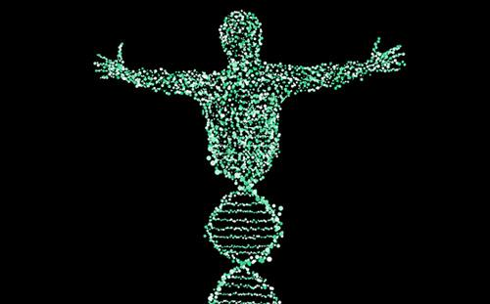
Human Nature is written in our genes?

Slide 3


Human Nature as a “Blank Slate”: social context is the Key

Slide 4
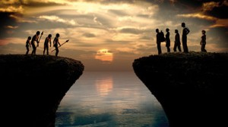
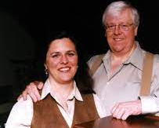
Evolutionary Psychology: the key to human nature is in our evolutionary past.
Leda Cosmides and John Tooby

Slide 5
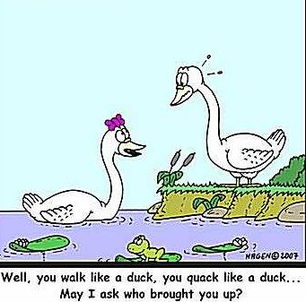
Interactionism: Nature and nurture both matter. How do we understand their interaction?

Slide 6
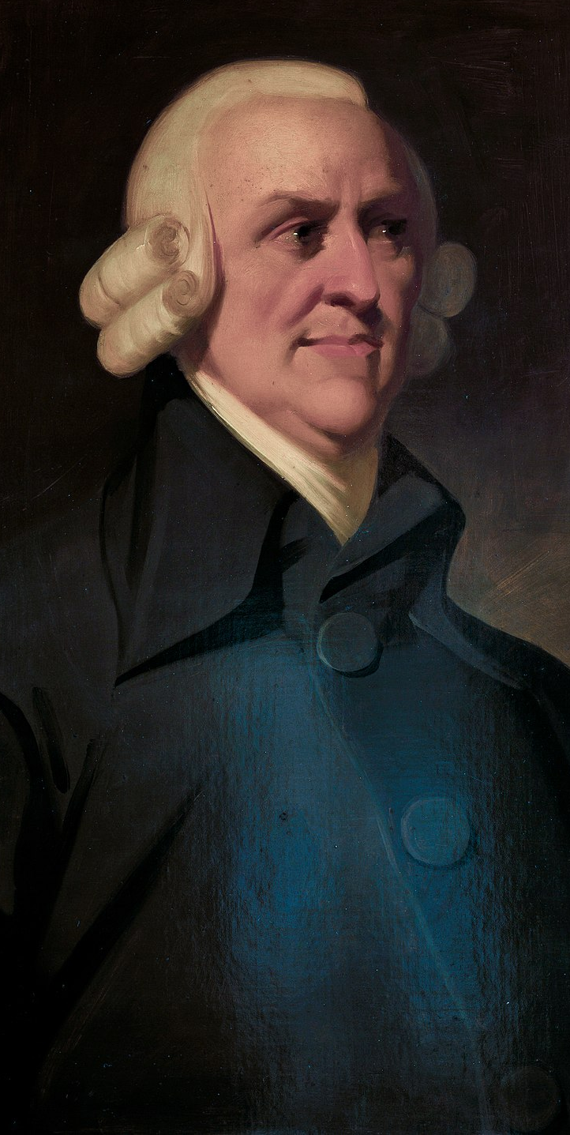
“The difference of natural talents in different men, is, in reality, much less than we are aware of; and the very different genius which appears to distinguish men of different professions, when grown up to maturity, is not upon many occasions so much the cause, as the effect of the division of labour. The difference between the most dissimilar characters, between a philosopher and a common street porter, for example, seems to arise not so much from nature, as from habit, custom, and education. When they came into the world, and for the first six or eight years of their existence, they were, perhaps, very much alike, and neither their parents nor play-fellows could perceive any remarkable difference. About that age, or soon after, they come to be employed in very different occupations. The difference of talents comes then to be taken notice of, and widens by degrees, till at last the vanity of the philosopher is willing to acknowledge scarce any resemblance."
Adam Smith,
On the Wealth of Nations, Book I, Chapter 2.

Slide 7
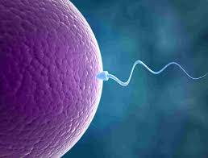
Biological sex is generally defined in relation to difference in gamete size

Slide 8
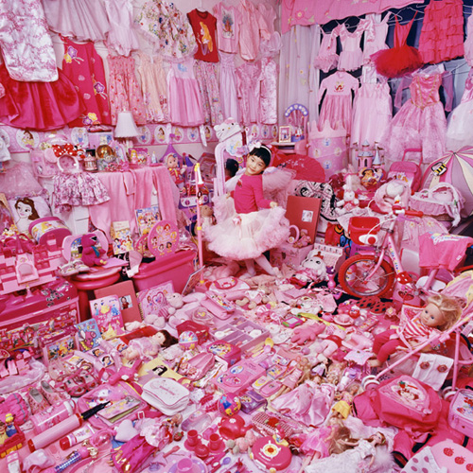
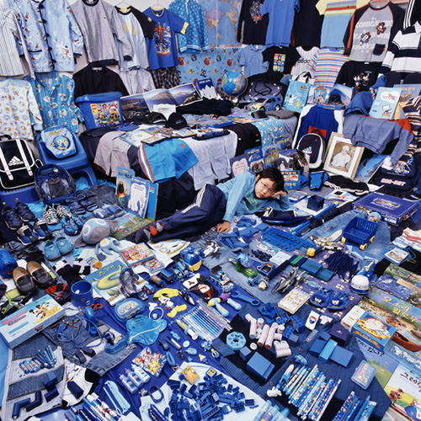
Brain, behavioural, and physiological differences continue to develop with systematically divergent inputs to boys and girls, interacting with subtle biological differences.
The Pink Project - Jeeyoo and Her Pink Things
The Blue Project - Jeonghoon and His Blue Things
http://www.jeongmeeyoon.com/aw_pinkblue.htm

Slide 9
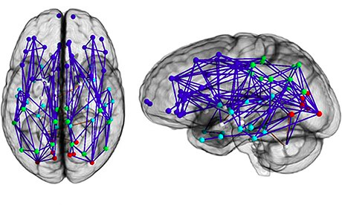
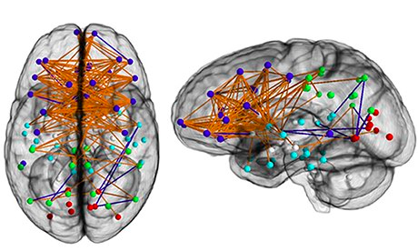
“Male and Female Brains Wired Differently, Scans Reveal”
Guardian, Monday 2 December 2013
“Ragini Verma, a researcher at the University of Pennsylvania, said the greatest surprise was how much the findings supported old stereotypes, with men's brains apparently wired more for perception and co-ordinated actions, and women's for social skills and memory, making them better equipped for multitasking.”
Why assume the wiring of the brain is a cause rather than an effect of gender difference?

Slide 10
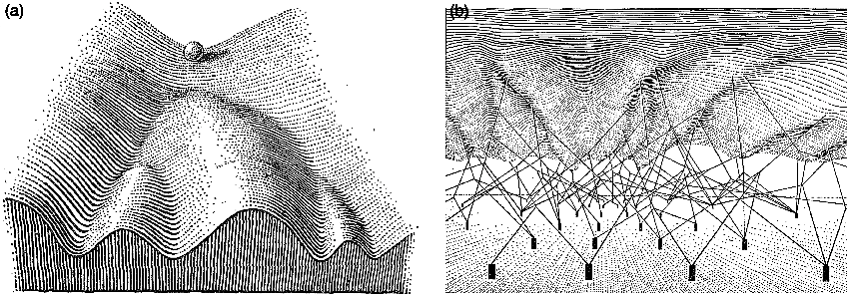
Waddington’s “epigenetic landscape”. On the left the pathways that can be taken by a developing biological system (cell, organism, etc.). On the right the pegs represent possible changes (epigenetic) to the shape of the landscape that may effect the final destination of the rolling ball.
C. H. Waddington (1957). Drawing by John Piper.

Slide 11
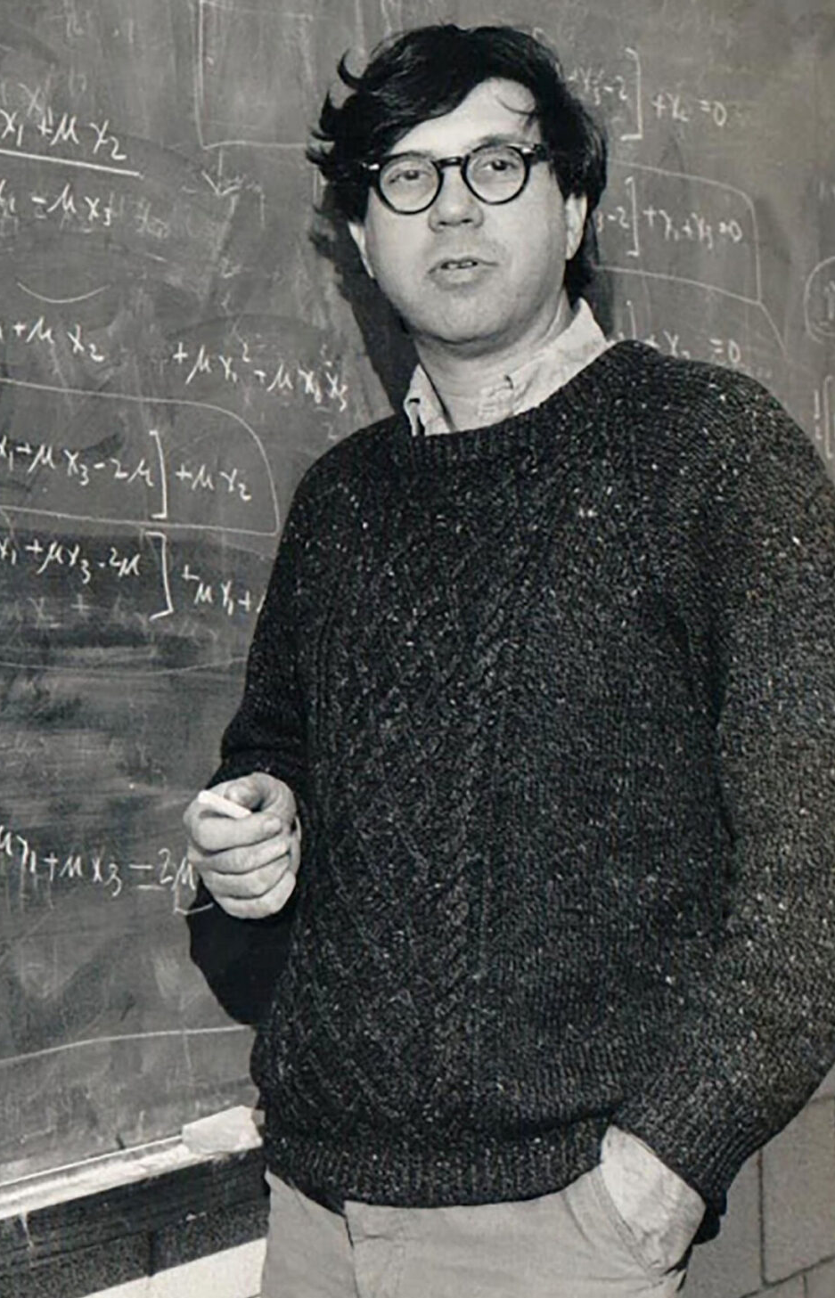
“based on randomly chosen genetic differences, human races and populations are remarkably similar to each other, with the largest part by far of human variation being accounted for by the differences between individuals…
Human racial classification is of no social value and is positively destructive of social and human relations.” (Lewontin 1972)
Richard Lewontin (1929-2021)

Slide 12
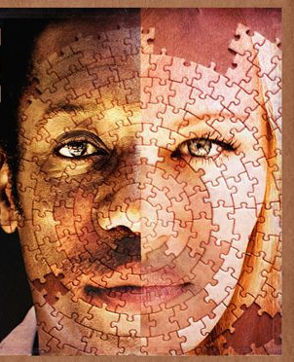
“Analysis of genomes from around the world establishes that there is a biological basis for race, despite the official statements to the contrary of leading social science organizations. An illustration of the point is the fact that with mixed race populations, such as African Americans, geneticists can now track along an individual’s genome, and assign each segment to an African or European ancestor, an exercise that would be impossible if race did not have some basis in biological reality.” (Nicholas Wade, Time, May 9, 2014)

Slide 13
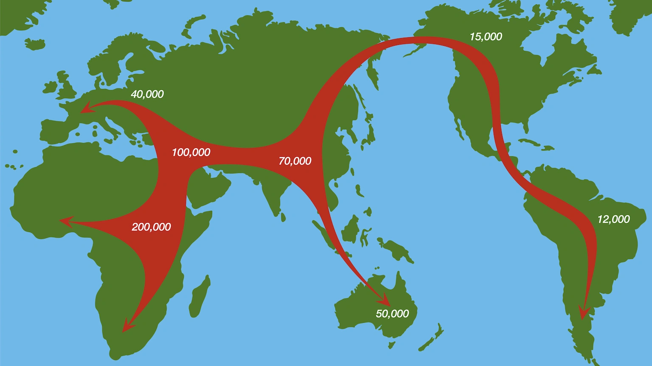
This map shows the very general overall tendencies of human migration. The racial groups distinguished by structure reflect the timings of these movements, and sometimes of much more minor migrations.

Slide 14
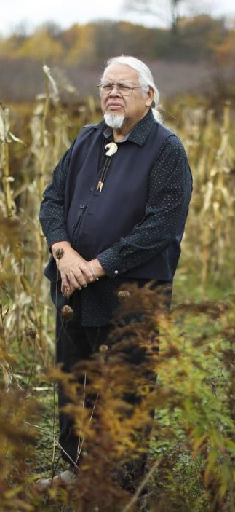
"If you ask me what is the most important thing that I have learned about being a Haudenosaunee, it's the idea that we are connected to a community, but a community that transcends time.
We're connected to the first Indians who walked on this earth, the very first ones, however long ago that was. But we're also connected to those Indians who aren't even born yet, who are going to walk this earth... And our job in the middle is to bridge that gap. You take the inheritance from the past, you add to it, your ideas and your thinking, and you bundle it up and shoot it to the future. You come here to work hard so that the future can enjoy that benefit."
Rick Hill Sr. (Tuscarora)
Chair, Haudenosaunee Standing Committee on The Native American Graves Protection and Repatriation Act
Notes:
Recognizing the lineage…

Slide 15
Thank you for listening.
The next and final lecture, on the topic Free Will, will be on Thursday, May 11th, same time and place.

Slide 17
“The average proportion of genetic differences between individuals from different human populations only slightly exceeds that between unrelated individuals from a single population. That is, the within-population component of genetic variation, estimated here as 93 to 95% (Table 1), accounts for most of human genetic diversity” (Rosenberg et al., Science, 2002)

