Slide 1

Evolution
Gifford Lecture 2
May 3, 2023
John Dupré, Egenis, University of Exeter

Slide 2
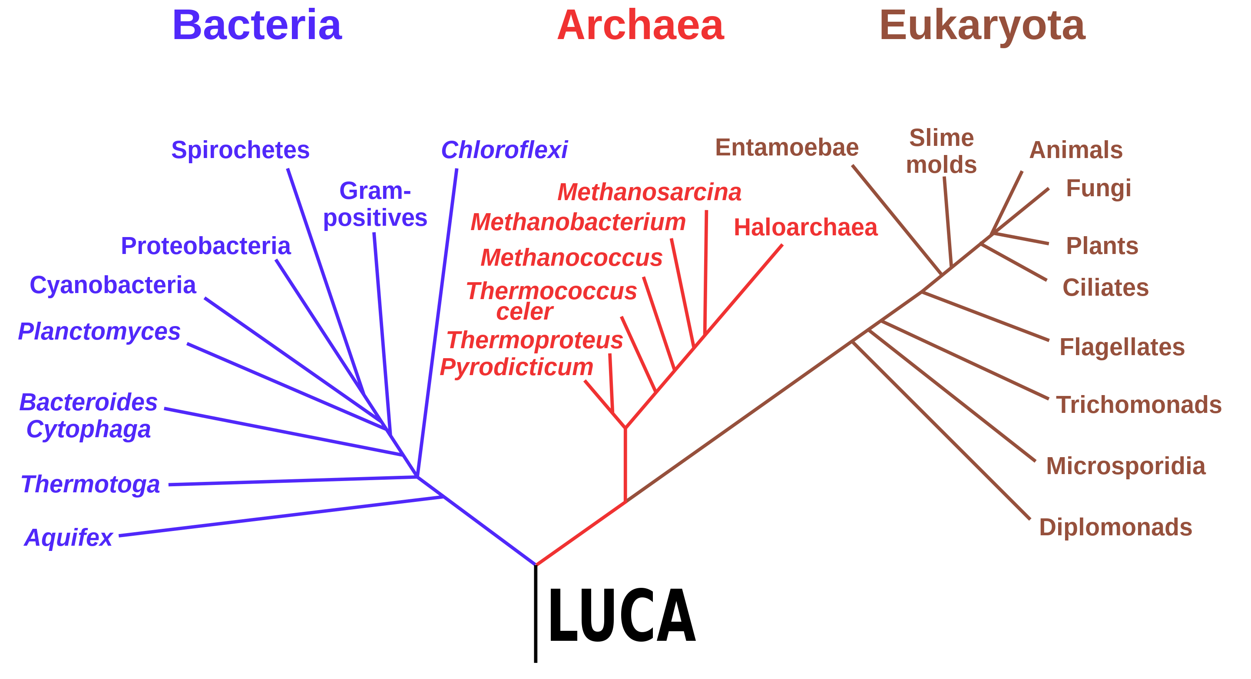
Tree of Life: Large Scale

Slide 3
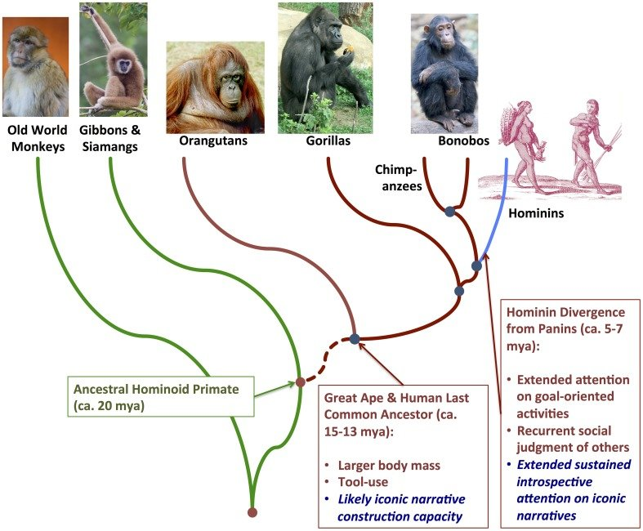
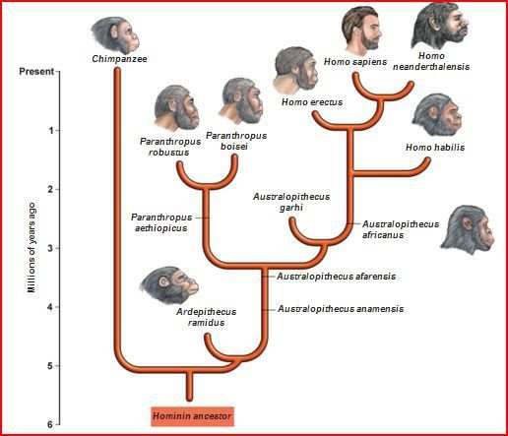

Fine Scale

Slide 4
Clades and Lineages
Clades look forwards while lineages look backwards
A clade contains all the descendants of an ancestral species.
A lineage is a process. It is a connected sequence of species leading to a target destination.
Lineages are what evolve, or where evolution happens

Slide 5
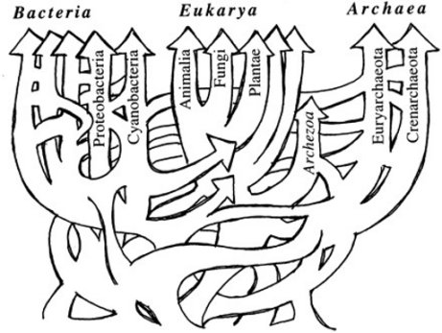
Lateral gene transfer in the early evolution of life. (Ford Doolittle, Science 1999.)

Slide 6
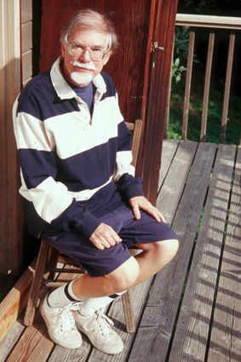
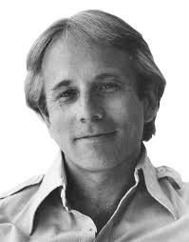
What Is a Species? Applying Process Ontology
Michael Ghiselin and David Hull: Species are Individuals (not Kinds): branches of the phylogenetic tree
Units of evolution vs. units of classification*
As units of evolution (some) species are individuals, but individual processes not things
Evolution is the change within such processes
*Dupré, "In Defence of Classification", Stud. Hist. Phil. Biol. and Biomed, Sci., 32, 2001.

Slide 7
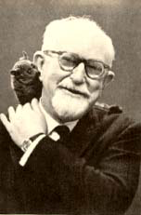
What Evolves?
A species is “a lineage (an ancestral descendant sequence of populations) evolving separately from others and with its own unitary evolutionary role” (Simpson 1961)
Evolution occurs when distribution of traits in a lineage at t₂ differs from distribution at t₁.
G. G. Simpson

Slide 8
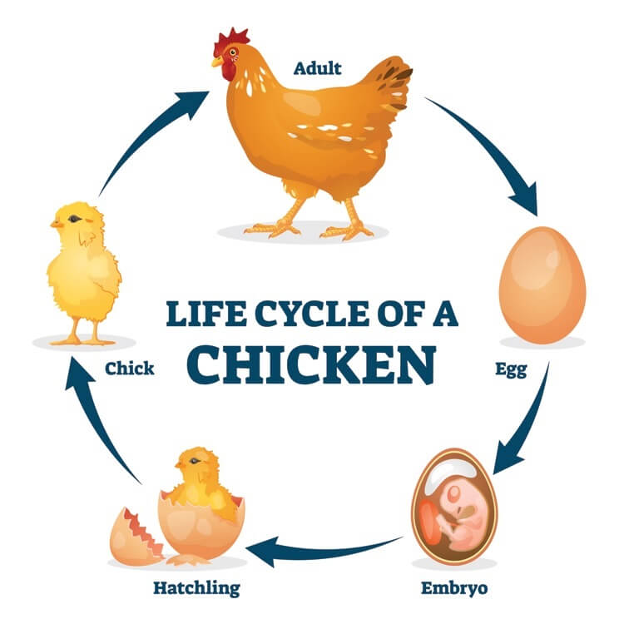
Lineage Stability 1: Reproduction
A stable lineage consists of developmental systems (organisms) that reproduce themselves and thus extend the lineage into the future.
(Neither comes first!)

Slide 9
“Most organisms do exhibit more internal organization than most species, but this difference is one of degree, not kind. Most species do not exhibit the internal organization common in vertebrate organisms, but the same can be said for plants as organisms. Most plants do not exhibit the internal organization common in vertebrate organisms.” (Hull, 1999, 32).
Many find it counterintuitive that an organism is a process and that a lineage is an individual. I argue that both are individual processes.

Slide 10
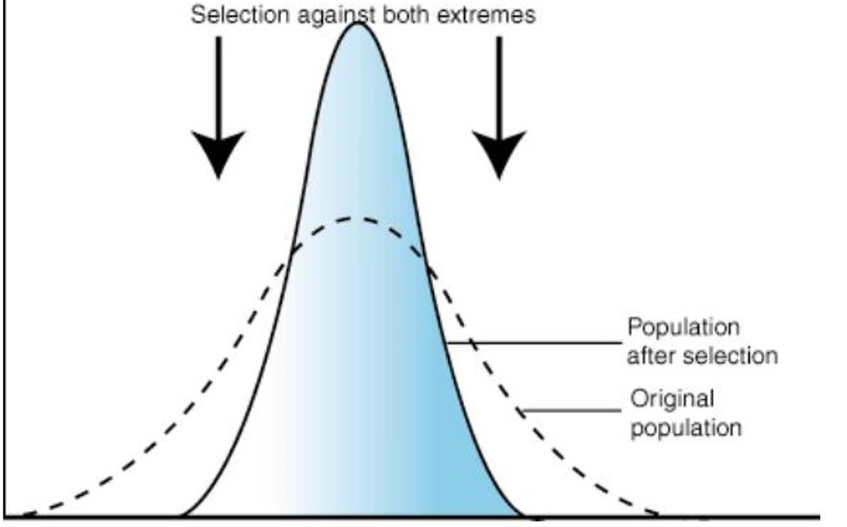
Lineage Stability 2: Natural Selection
A process perspective highlights the importance of stabilizing selection.
Natural selection ensures that the process remains within a space constrained by the conditions of existence.

Slide 11
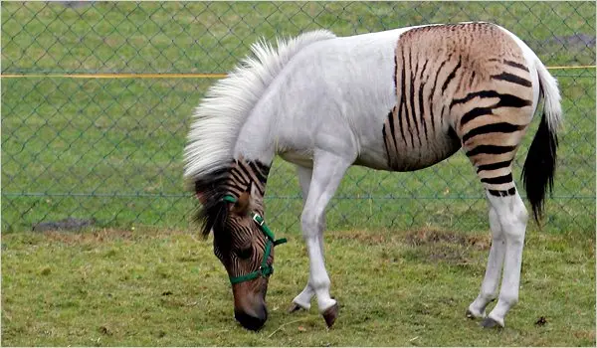
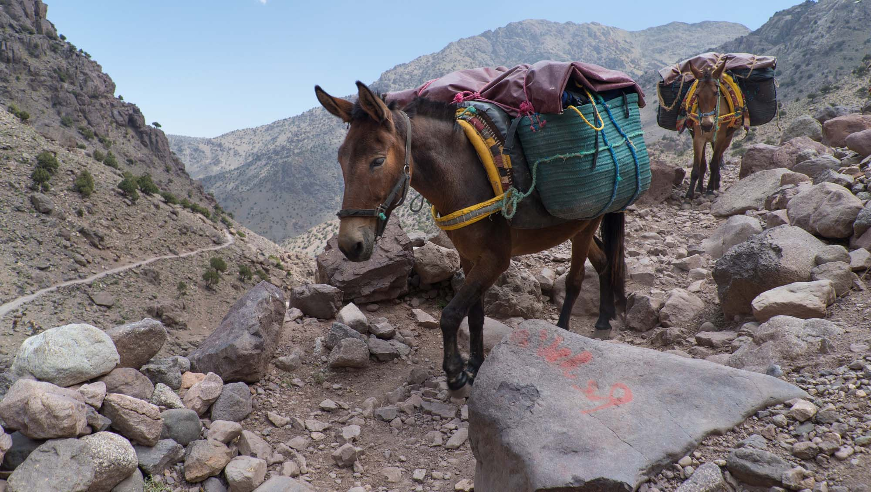
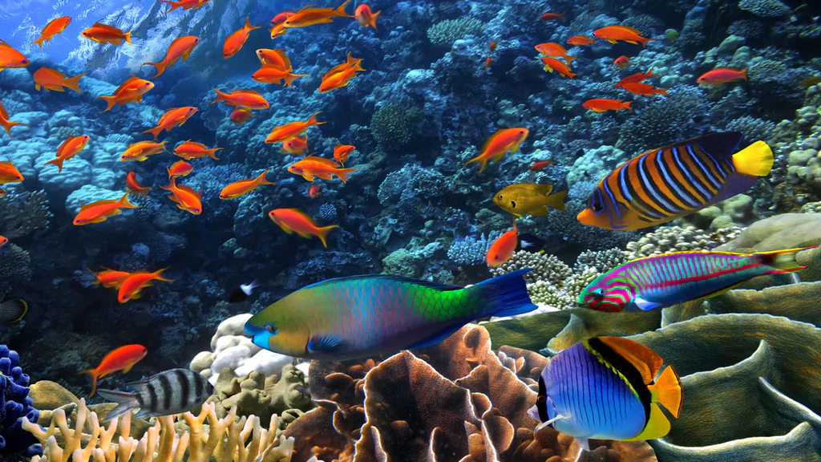
Lineage Stability 3: Boundary Enforcement via Sexual Reproduction
Sexual reproduction enforces (to a variable degree) the boundaries between related sexual species.
Isolating mechanisms, genetic incompatibilities and hybrid infertility, and mate recognition systems are important ways in which these boundaries are reinforced
Hybrid sterility: mules
Mate recognition

Slide 12
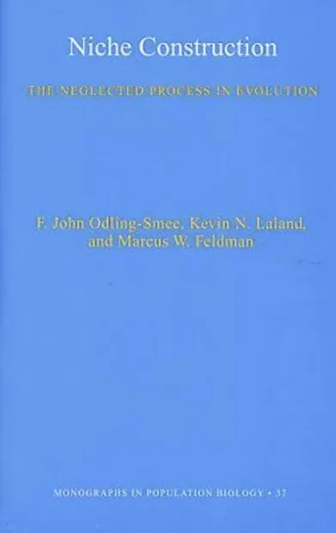
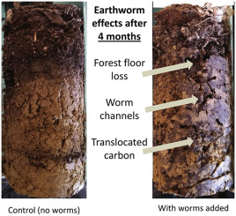
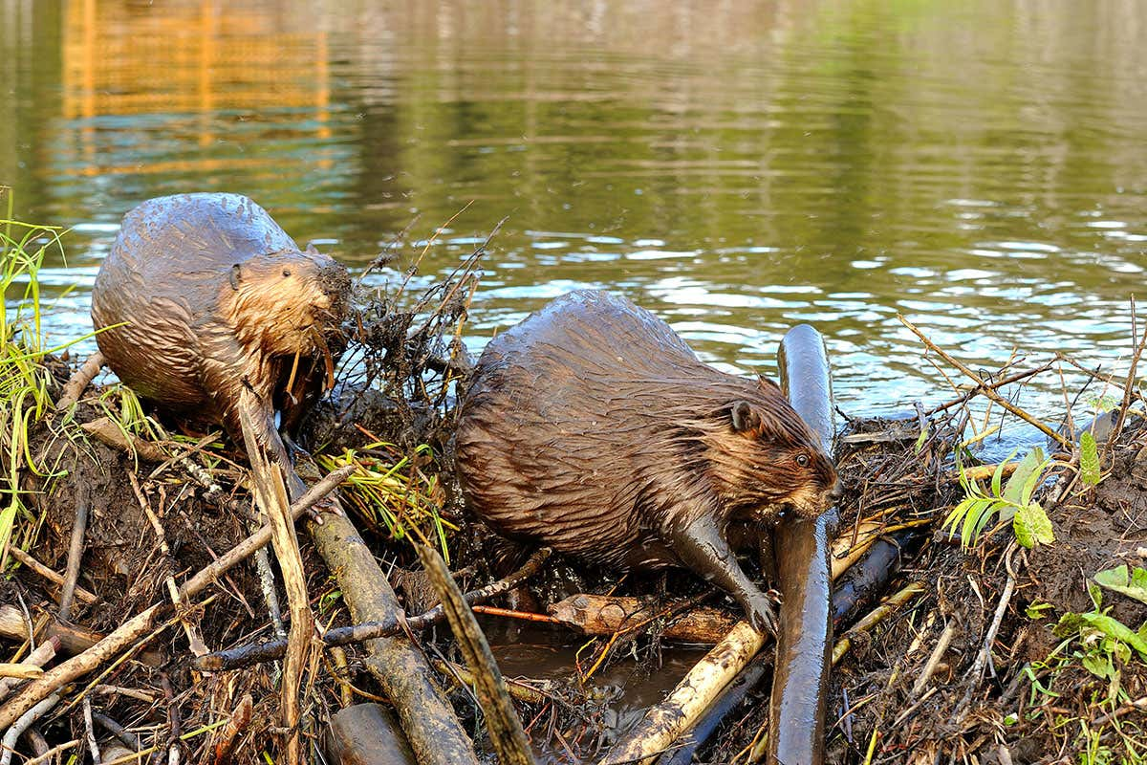
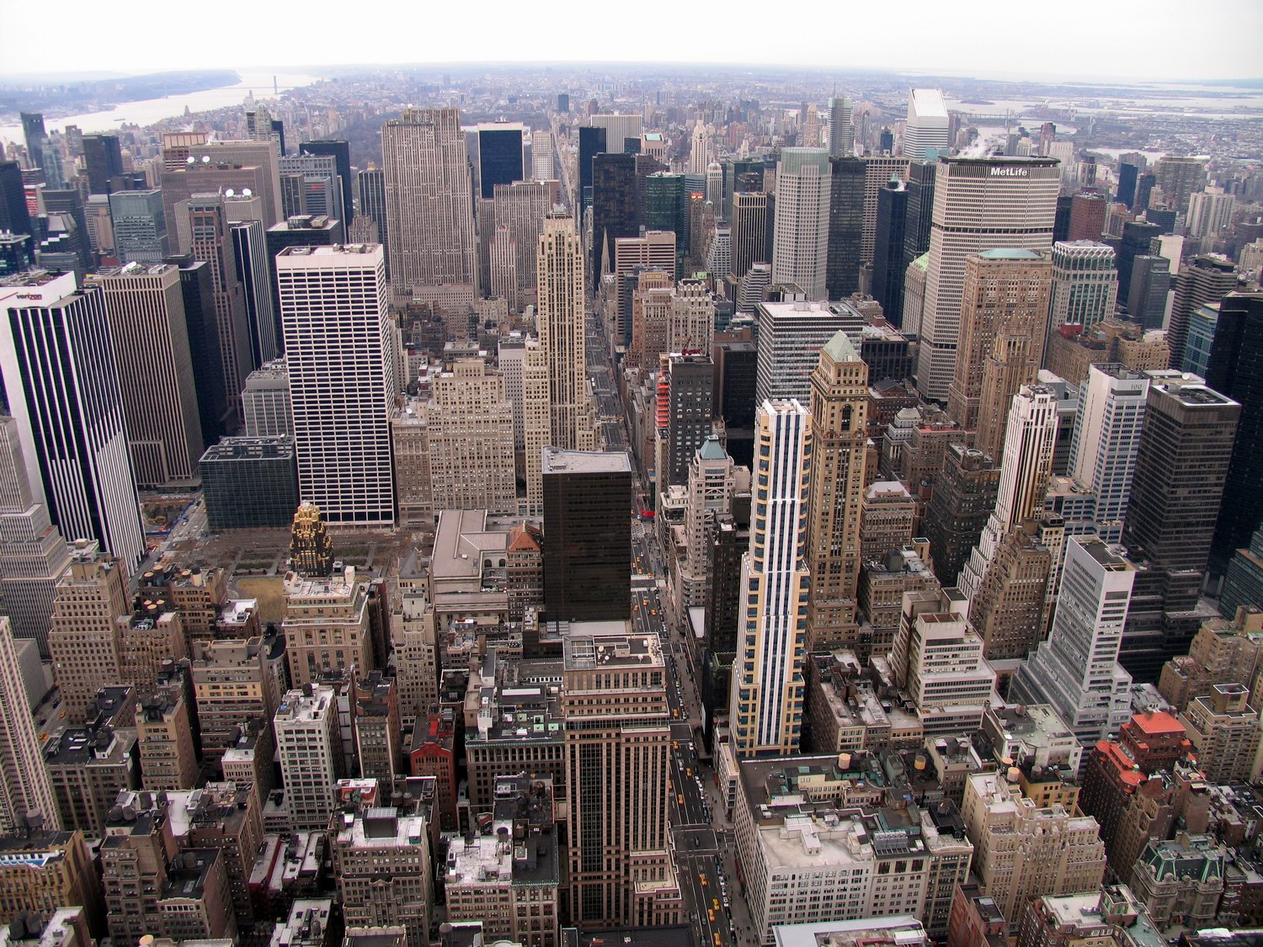
Lineage Stability 4: Niche Construction
Lineages do not respond only passively to the changing environment. They act to shape and maintain the environment in ways to which they are adapted

Slide 13
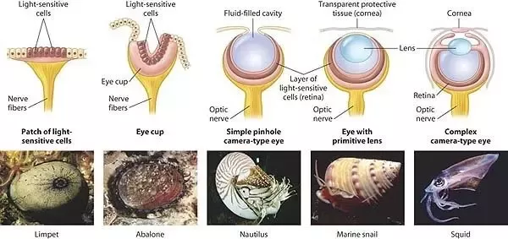
Some Stages in the Evolution of the (Mollusk) Eye

Slide 14
Sources of Change to the Organisms (Developmental Systems) that Constitute Lineages
  Mutation, recombination, and horizontal acquisition of genes (including changes to architectural genes)
  Epigenetic changes replicated or reconstructed
  Imitation of parental behaviour
  Cultural transmission
  Constructive neutral evolution: non-adaptive but irreversible increase in complexity
Selection is always a filter; but selection cannot create novelty

Slide 15
Two Meanings of “Species”
All organisms belong to a species in the sense of a classificatory term.
But not all species in that sense are coherent lineages.
The term “species” is radically ambiguous—it can be used to refer to ontologically quite distinct categories, an individual or a kind.
This can cause a good deal of philosophical confusion…

Slide 16
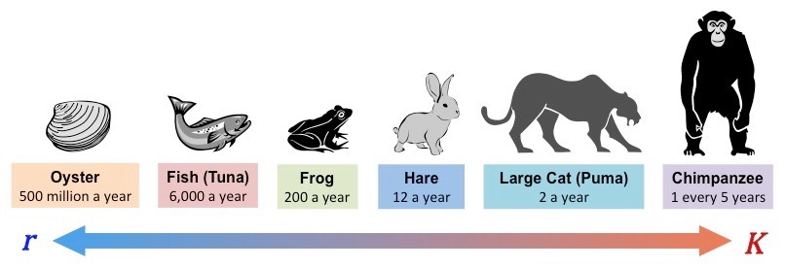
r-Selection and K-Selection
r-selected species produce very many offspring. Maximizes selection
K-selected species produce few “high-quality” offspring. Promotes integration.

Slide 17
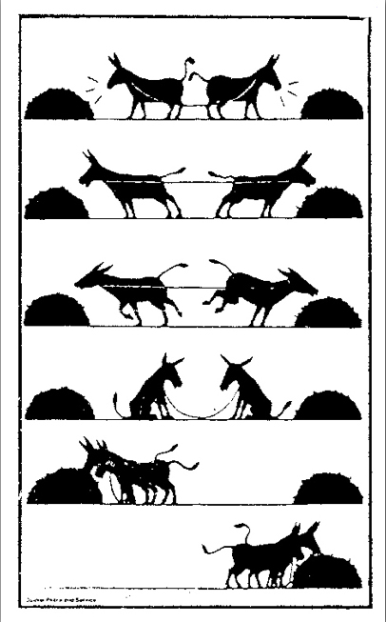
Competition and Cooperation
Integration of species (and organisms) involves the transition from competition to cooperation (cells/multicellular organisms; parasitism to symbiosis; group selection; etc.)
When lineages are coherent processes we should expect elements of cooperation as well as competition
Much interaction is on neither extreme, but somewhere on a spectrum. A new word is helpful, and I have in the past suggested we talk rather about “Collaboration”.

Slide 18
Thank you for listening.
The next lecture, on the topic Humans and their Fellow Travellers, will be on Monday, May 8th, same time and place.

Slide 19


