Slide 1

Free Will
Gifford Lecture 6
May 13, 2023
John Dupré, Egenis, University of Exeter

Slide 2
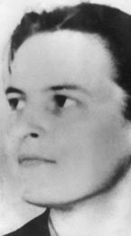
Note on the Malign Epistemic Effects of Astronomy
“The high success of Newton's astronomy was in one way an intellectual disaster: it produced an illusion from which we tend still to suffer. This illusion was created by the circumstance that Newton's mechanics had a good model in the solar system. For this gave the impression that we had here an ideal of scientific explanation; whereas the truth was, it was mere obligingness on the part of the solar system, by having had so peaceful a history in recorded time, to provide such a model”.
G.E.M.Anscombe, 1971

Slide 3
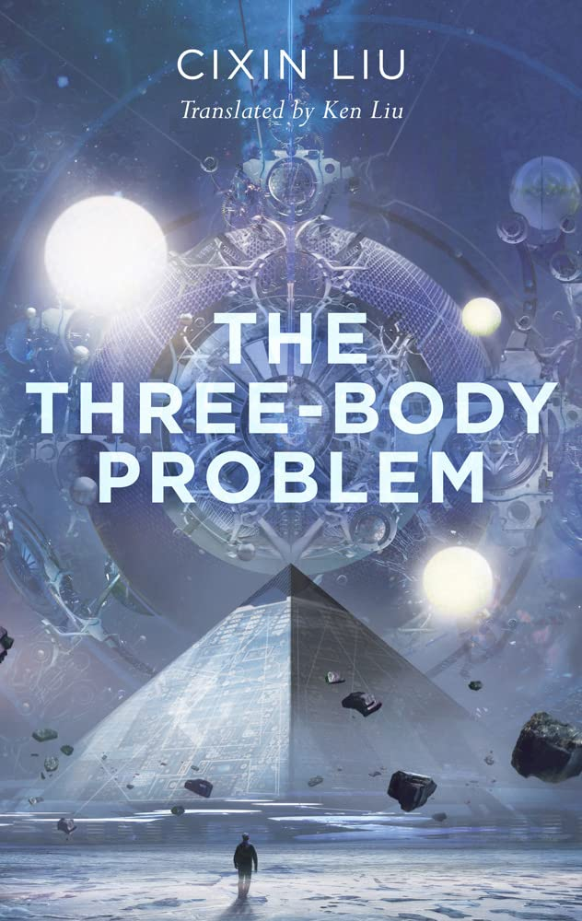
Compare…
We might have had a very different metaphysics if we lived in a solar system in principle not amenable to mathematical explanation and prediction.

Slide 4
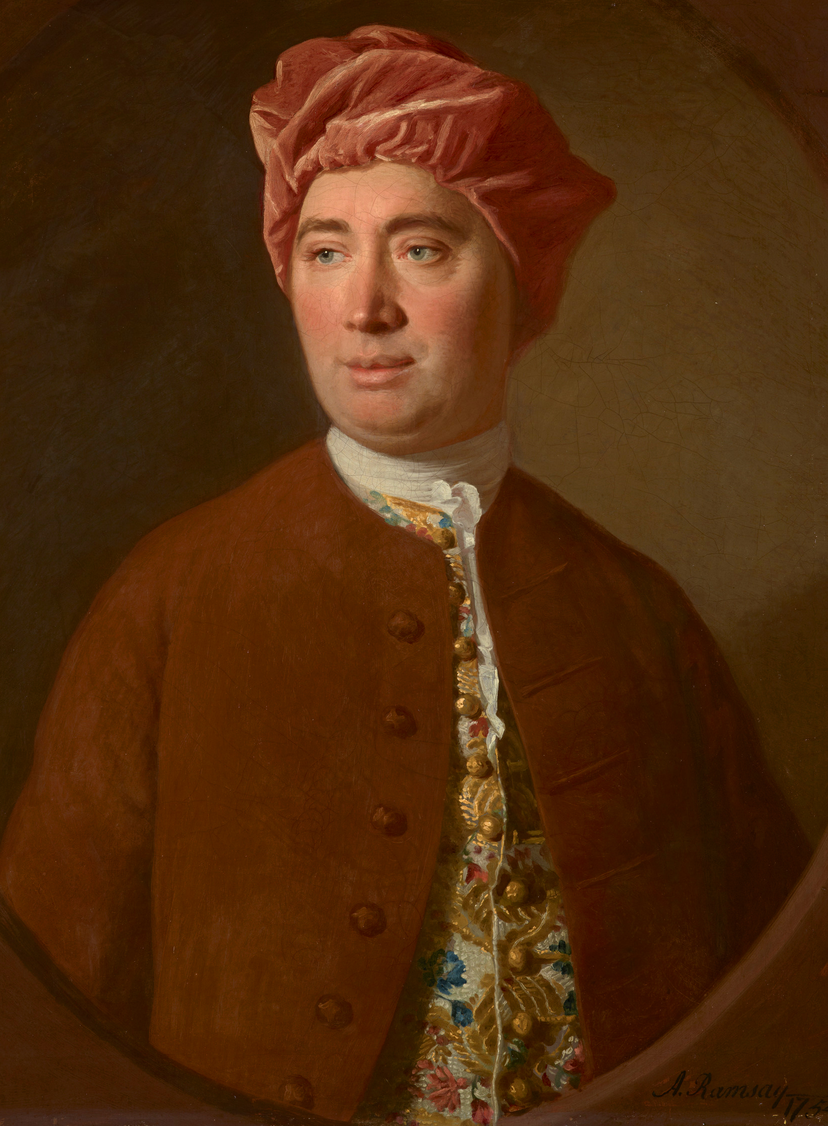
Liberty is “a power of acting or not acting, according to the determinations of the will; that is, if we choose to remain at rest, we may; if we choose to move, we also may.” This sort of liberty is “universally allowed to belong to every one, who is not a prisoner and in chains”.
David Hume (1711-1776).

Slide 5
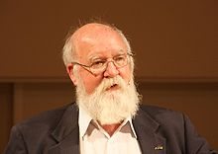
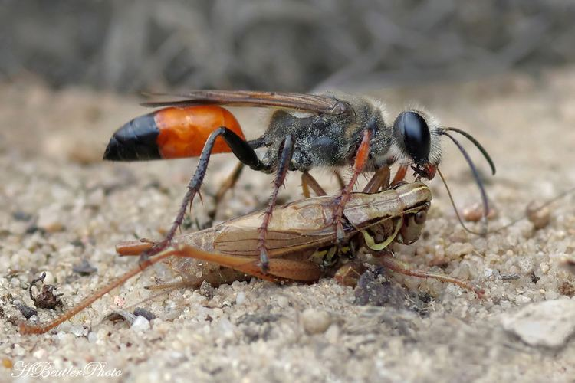
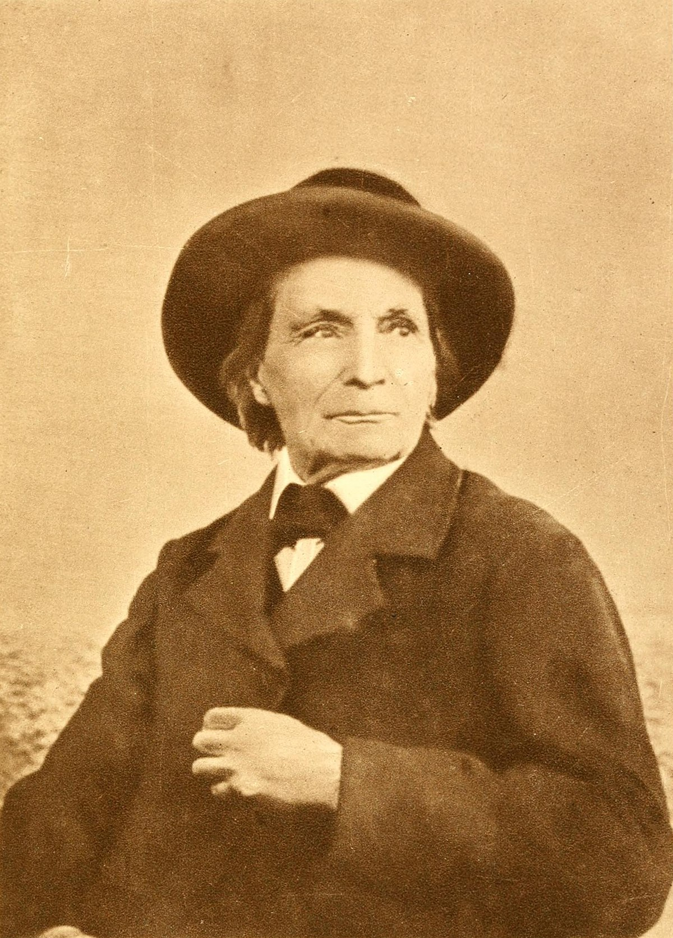
Daniel Dennett (1942- )
Sphex ichneumoneus
Jean-Henri Fabre (1823-1915)

Slide 6
Criteria of Agentiality
Goals
Learning
Creativity
Foresight/Intelligence

Slide 7
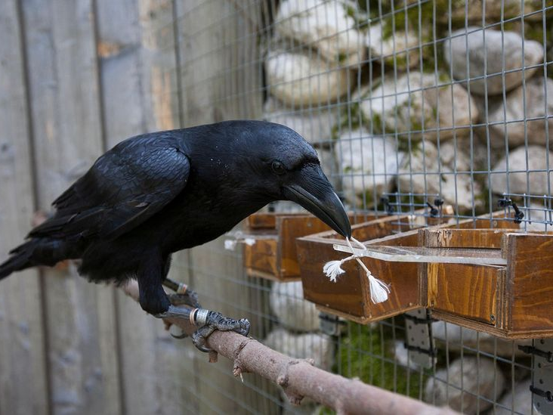

Slide 8
Criteria of Agentiality
Goals
Learning
Creativity
Foresight/Intelligence
Direction of behaviour towards long term goals

Slide 9

Free Will
Act in accordance with strongest current desire
Act in accordance with plans or principles
Do I have real choices?
Could I have done otherwise?

Slide 10
